Slide 1
JaxCareConnect Doing Greater Good. Together. Creating a Primary Health Care Safety Net System for Duval County

Slide 2
Shared Vision
Every resident of Duval County has access to high-quality, comprehensive healthcare – regardless of insurance status or ability to pay
Notes:
Reference Upholding Org Values doc

Slide 3
The problem we want to solve...
The lack of a coordinated system of care limits access to healthcare
Unlike many other counties, Duval is unique in the number of providers of free and charitable primary care and hospital systems – making centralized care models a challenge
Low income and underserved populations lack information about and connection to available healthcare services
Providers lack capacity to fully coordinate care across the continuum and through transitions of care
Low-income and underserved populations lack information about health insurance and other relevant benefits, and how to access those for which they are eligible
Providers lack capacity for ongoing outreach, education, marketing

Slide 4
As a result…
Low-income and underserved populations experience barriers to care, often:
Seeking primary care through hospital emergency departments
Foregoing medical care because unaware of their eligibility or how to access coverage
Duplicating services as they move from provider to provider – or appropriate services not provided at all
Less than optimal health outcomes consistently experienced
Foregoing medical care due to lack of transportation

Slide 5
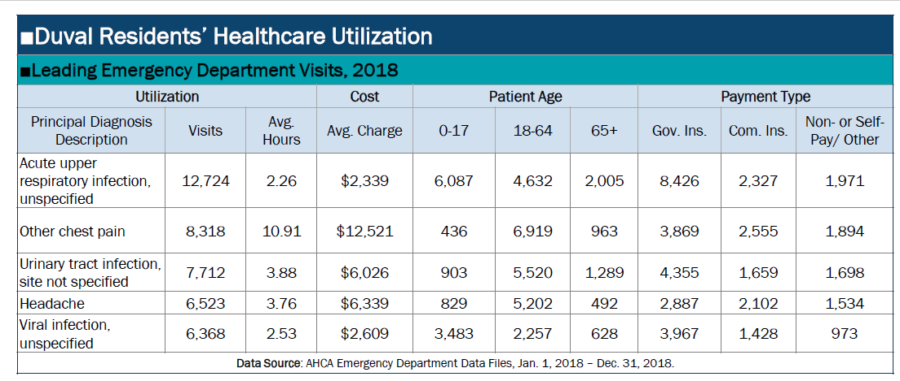
And Includes Impacts to the Community:
Higher costs of care born by the community for conditions better treated in primary care than an ED
6,176 Non-pay / Self-pay Visits

Slide 6
This experience is further confirmed by . . .
The Community Health Needs Assessment, authored by the Jacksonville Nonprofit Hospital Partnership, which concluded that:
Low‐wage earners living paycheck‐to‐paycheck are threatened by any health complication that affects their ability to pay rent and be food‐secure
Poverty is one of the biggest drivers in health disparities and education levels
84.3% of adults in Duval County have health insurance
16.6% of people in Duval County live below poverty level
www.hpcnef.org/jacksonville-nonprofit-hospital-partnership-community-health-needs-assessment

Slide 7
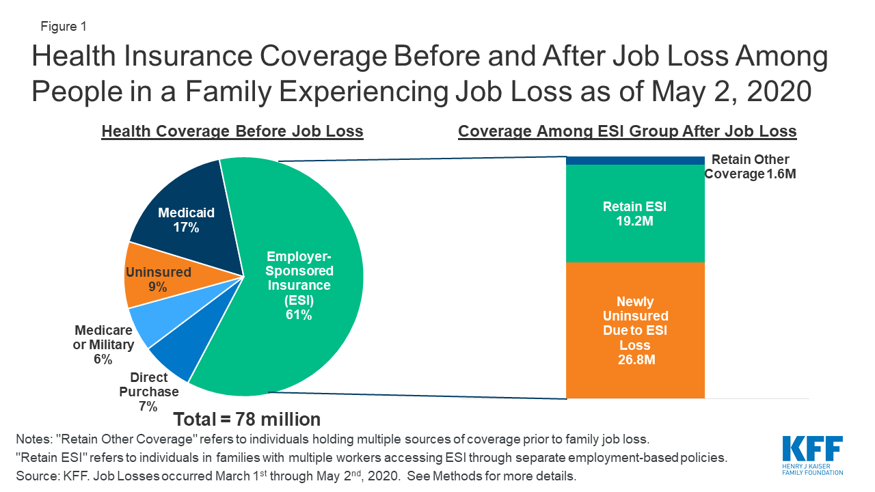
Add COVID Impacts:
https://www.kff.org/coronavirus-covid-19/issue-brief/eligibility-for-aca-health-coverage-following-job-loss/

Slide 8
Add COVID Impacts:
While many communities have seen clinic closures due to the pandemic, the safety net partners in Duval County have continued to adapt and collaborate to see both existing and new patients

Slide 9
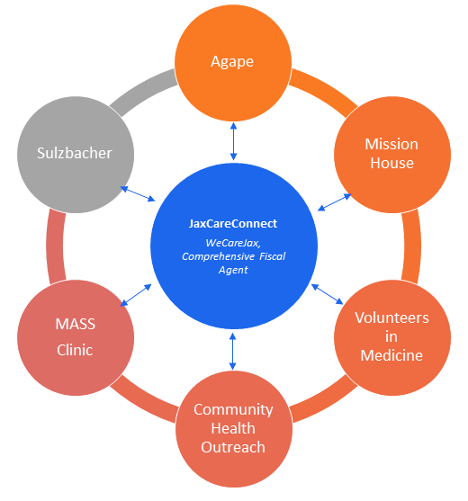
JaxCareConnect Initial Partners & Connections:

Slide 10
Identified Shared Services to Capture 2,000 Patients:
During Collaborative Planning:
Partners identified excess capacity to serve up to 2,000 new patients over the coming three years
Preventing unnecessary emergency department utilization by these new patients could save $4.4 Million
Pandemic projected to increase number of uninsured adults due to insurance tied to employment (Locally, May Unemployment officially reported at 11.7% - up from 4.3% in February)
Consolidated Intake and Referral (humans + technology)
Patient Care Advocates / Transition of Care Managers
Marketing / Community Education - Online and Local Presence

Slide 11
Integrated Intake and Referral
Common Intake and Referral Form (the “common form”)
Access link via cell or computer; also via phone or in person
Easy to access and complete by patient, provider, hospital social worker, advocates
Directs the patient to the appropriate providers based on eligibility criteria, need, geography
Follow-up by provider guaranteed
Patient Access
Call to central triage, any collaborative partner, or 211
Walk-ins at Collaborative clinic sites
Links to “Provider Collaborative” home page from COJ.net, partner providers and hospital web sites, library web site, etc.

Slide 12
JaxCareConnect Administrator
Employed by WeCareJax with funding support from partners
Responsibilities include:
Coordinate and oversee all services / activities of the Collaborative
Coordinate steering committee meetings, activity, and follow-up
Manage JaxCareConnect budget and coordinate all fundraising and revenue generation
Identify, secure, and manage all external contractors
Maintain data platforms and provide ongoing and as-needed reporting to the Collaborative and partners
Maintain website and other communications platforms

Slide 13
Patient Care Advocates
The Patient Health Advocate (PHA) will have a unique role in assisting patients who are referred for care. Employed/Contracted by WeCareJax and managed by the JaxCareConnect Administrator, a successful PHA will:
Build working relationships, solve problems, and support patients while they navigate the safety net health care system
Assist patients in understanding their rights and responsibilities regarding care and referrals received
Verify current eligibility for services, evaluate current insurability options, and assist with access
Help patients understand their care coordination plan
Assist patients in accessing available social services as needed
Support transition of care from emergency department or inpatient to patient-centered medical home

Slide 14
Why this solution? For up to 2,000 Uninsured Neighbors:
Will create a true “safety net” for care that:
Enhances and simplifies access to care
Increases usage of partner clinics as more people are brought into care and provided with medical homes, and distributes patients appropriately across providers
Minimizes risk to access if any one partner struggles
Will reduce use of hospital emergency departments as primary care sites
Will enhance providers’ ability to collect / analyze outcome, usage, and cost data
Will be more cost-efficient and a better use of community resources

Slide 15
Evaluation and Metrics
Engage evaluators as we build the model
Collect / analyze data related to, for example:
Health Outcomes (e.g., diabetes, hypertension, asthma)
Number / rate of accessing insurance coverage
System savings (e.g., savings from ED diversion; savings to individual partner providers)
Patient “no-show” rates
Referrals to social services

Slide 16
JaxCareConnect Immediate Action Plan: Infrastructure Build and Prepare for Community Launch (August 2020 – January 2021)
Hire a Program Administrator (August - October 2020)
JaxCareConnect Administrator: Carries out three months of research, development, and planning activities in preparation for project launch at end of January 2021 (November 2020 – January 2021)
Hire Patient Health Advocates (November – December 2020)
JaxCareConnect Administrator: Researches all options to put a web-based common application/central intake system into practice by June 2021 (December 2020 – April 2021)
The Duval Safety Net Collaborative: meets at least monthly to manage the administrative details for the JaxCareConnect initiative (Ongoing)
Project Team: Prepare for JaxCareConnect soft launch in first quarter calendar year 2021

Slide 17
Secured Funding Partners for JaxCareConnect Pilot Workplan:
Riverside Hospital Foundation: Seed funder for planning period + three years of project pilot ($225,000)
Baptist Health: Support for three years of pilot ($150,000)
Community Foundation for Northeast Florida: Support for planning period plus 1st year of pilot ($75,000)
duPont Fund: support for first year of operations ($75,000)
2020 | 2021 | 2022 | 2023
Planning: Finalize Collaborative Agreements and Initial Workplan Secure Pilot Funding Hire Key Staff Initiate Contracts for Marketing, Web, and Technology Platform | Pilot Year One: Soft Launch Q1 PDSA: Plan, Do, Study, Act Refine Plan Public Launch Add Partners to Reduce Barriers to Care (SDOH) | Pilot Year Two: Increase Patients Add Partners Baseline Collaborative Clinical Measures | Pilot Year Three: Increase Patients Refine Technology Study Outcomes, Replicability Stabilize and Sustain

Slide 18
How Can We Accelerate Year 1 Successes to Serve More Patients in Years to Come?
Enhance interoperability in collaborative member Electronic Health Records systems ($30,000)
Add a third Patient Health Advocate in Year 1 (Salary + Benefits + Equipment @ $50,000)
Support capacity building at each clinic site to optimize clinic workflows, offer training, and add staffing hours to smoothly engage with the project’s PHAs and to help retain resulting new patients in care beyond the initial referral ($20,000 per clinic = $120,000)
Total Request: $200,000

